Slide 1
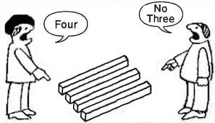
UNDERSTAND AND APPRECIATE DIFFERENT PERSPECTIVES

Slide 2
Apple - Perspective.mp4

Slide 3
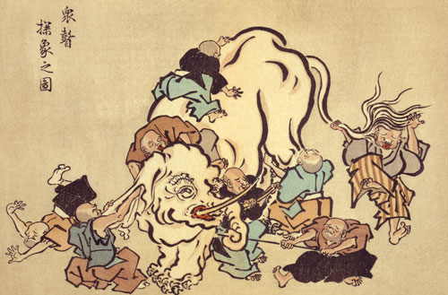

Slide 4
There is an old story of blind men and an elephant.

Slide 5
The blind men all meet and are asked to describe the elephant.

Slide 6
One says that an elephant is long and skinny like a snake.

Slide 7
The other says that the first doesn’t know what he is talking about and that an elephant is like the trunk of a tree, round and thick

Slide 8
The third says they are both wrong, that an elephant is wide and circular like a giant disc.

Slide 9
The third says they are both wrong, that an elephant is wide and circular like a giant disc.

Slide 10
In some versions, they stop talking, start listening and collaborate to “see” the full elephant.

Slide 11
Being a creative is often like being a blind person.

Slide 12
We are dealing with a problem that we cannot see.

Slide 13
Seeking inspiration

Slide 14
Cool Hunting

Slide 15
Cool Hunting is synonymous with seeking inspiration.

Slide 16
Coolhunting is a term coined in the early 1990s referring to a new breed of marketing professionals, called coolhunters.

Slide 17
It is their job to make observations and predictions in changes of new or existing cultural trends.

Slide 18


Slide 19
Cool Hunting is synonymous with seeking inspiration.

Slide 20
coolhunting.mp4

Slide 21
COOL PLACES

Slide 22
CLUB MASCARA, BULGARIA

Slide 23
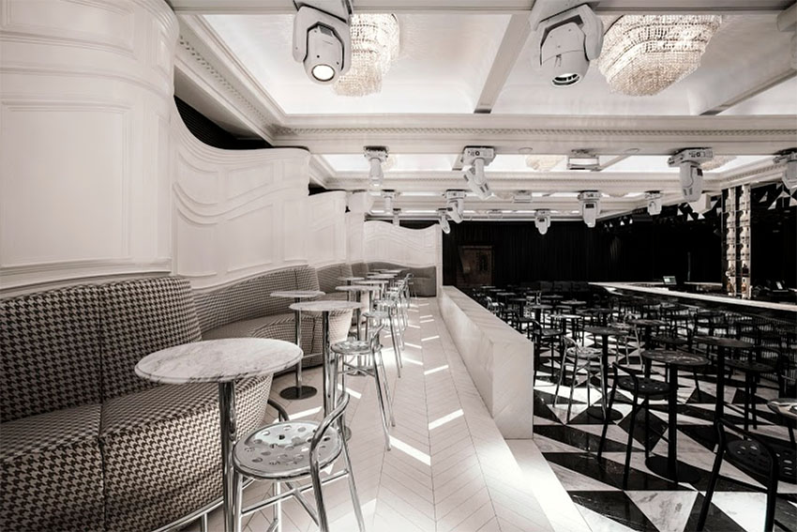

Slide 24
The designers of the Mascara nightclub in Sofia, Bulgaria, took their cues from the whimsical story of Alice in Wonderland

Slide 25
The designers of the Mascara nightclub in Sofia, Bulgaria, took their cues from the whimsical story of Alice in Wonderland

Slide 26
Everything appears to be slightly confusing – vertical and horizontal, up and down, soft and hard, solid and pliable.

Slide 27
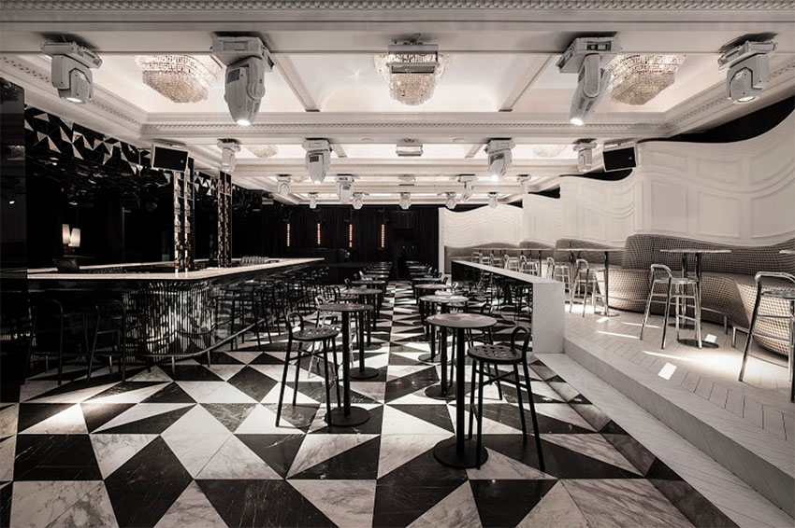

Slide 28
cool bakeries around the world.
Is there anything more basic, homey and familiar than a loaf of great bread? More and more of us are sick of white sliced bread in its plastic bag.

Slide 29
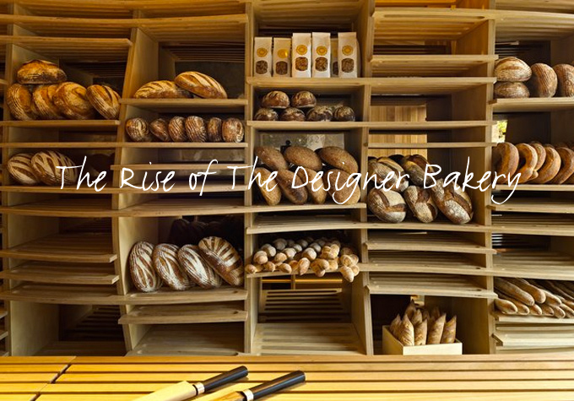

Slide 30
Blé Bakery on Agias Sofias in Thessaloniki, Greece, most certainly fits the bill.. It has the world’s largest wood oven – gigantic, at 12 meters (almost 40 feet) tall!

Slide 31
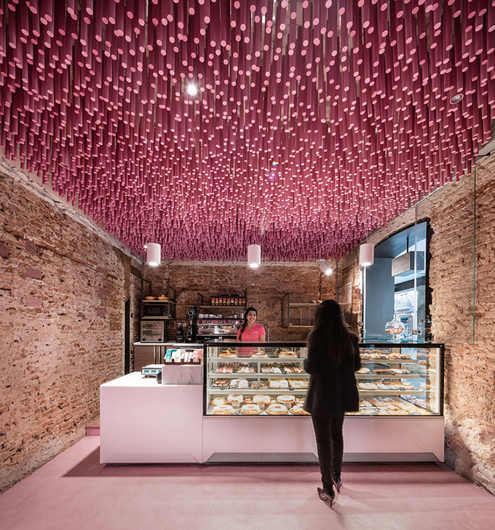

Slide 32
COOL PHOTOGRAPHY

Slide 33


Slide 34
seize the day – is an image that evokes many kinds of emotions and questions. A fashion shoot, smoke bombs of various colours, a foggy forest and a deserted highway. Click.

Slide 35
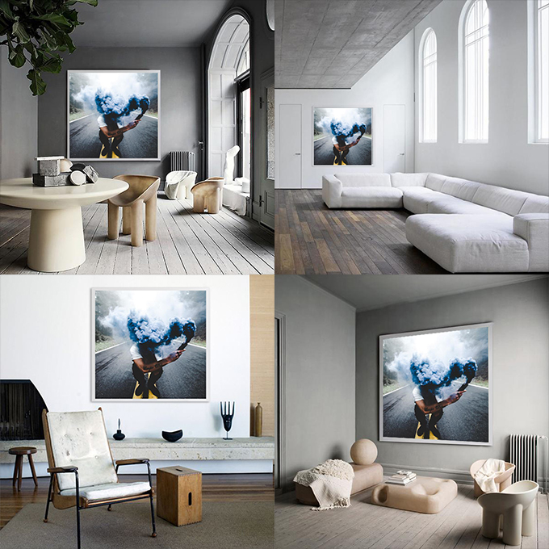

Slide 36
feng shui swimming pool and a digital cultural centre.”

Slide 37
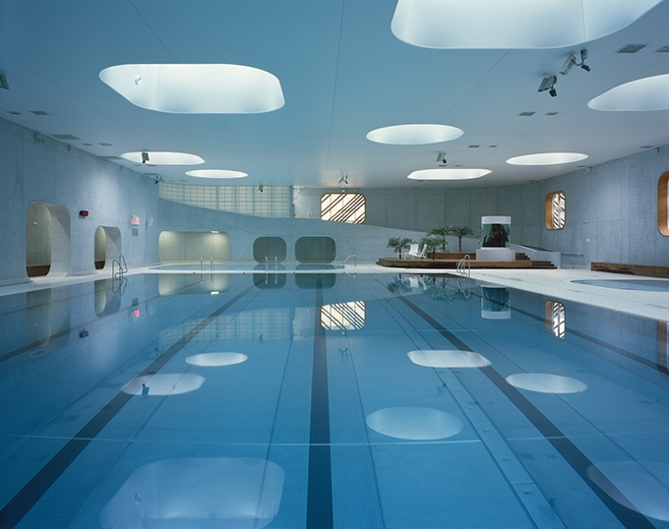

Slide 38
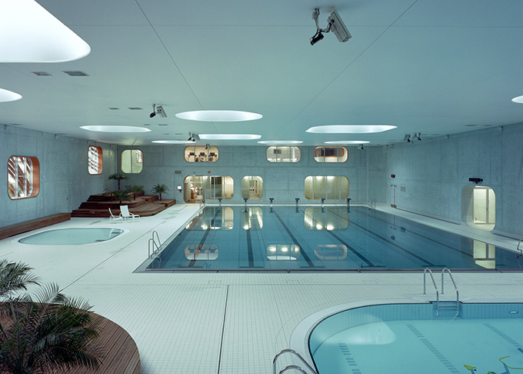

Slide 39
COOL WALLS

Slide 40
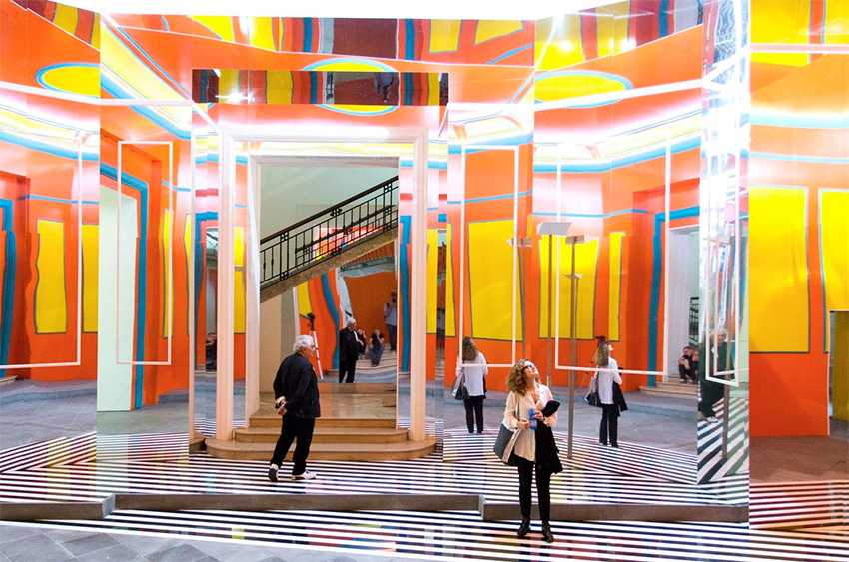

Slide 41
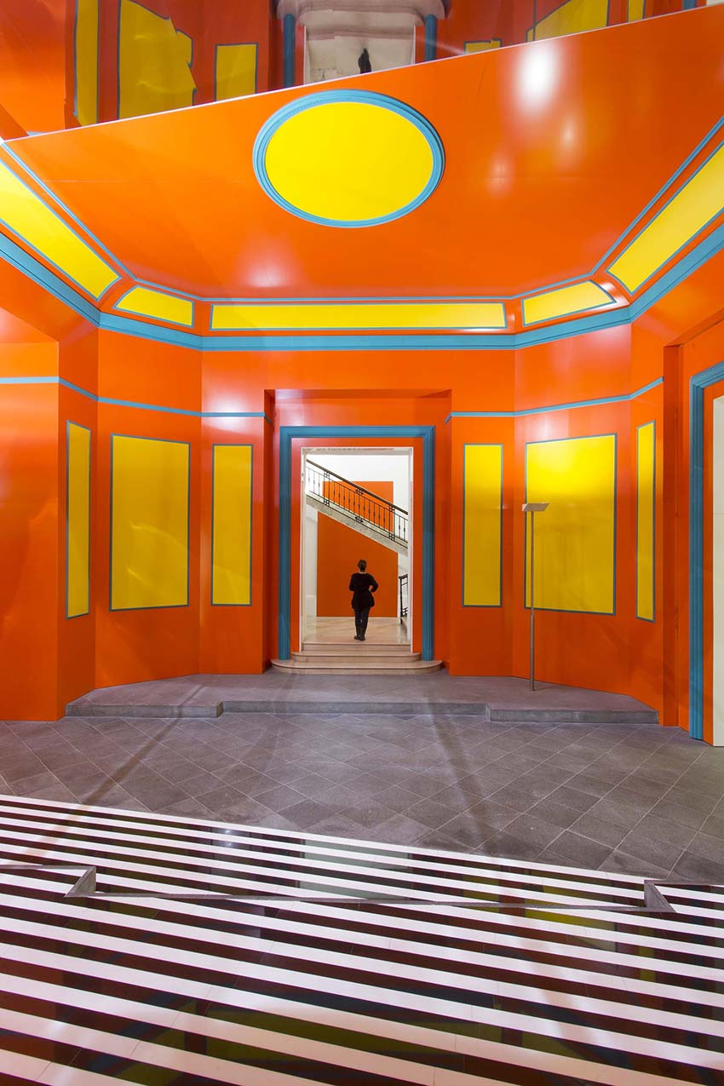

Slide 42
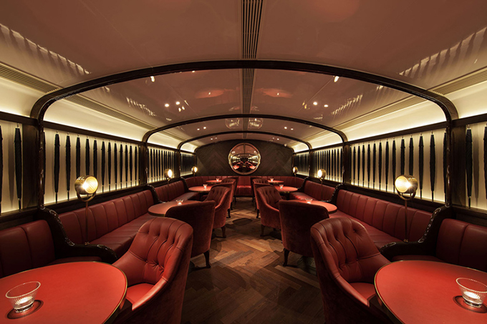
A VIP room seats 32 guests and resembles a first-class dining car of a luxury train

